Slide 1
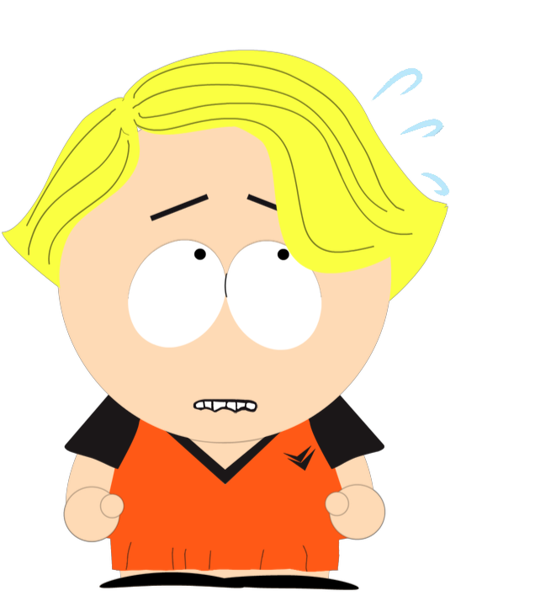
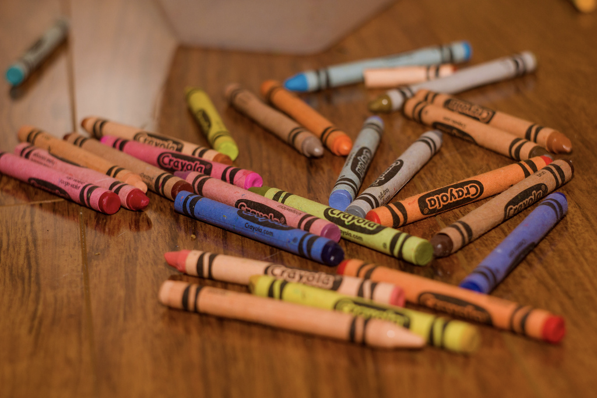
Notes:
This is Charlie. Charlie spills all his/her crayons in front of her class, and s/he feels embarrassed. Charlie has heard from her/his friend that if s/he feels embarrassed, her/his cheeks could turn pink.

Slide 2
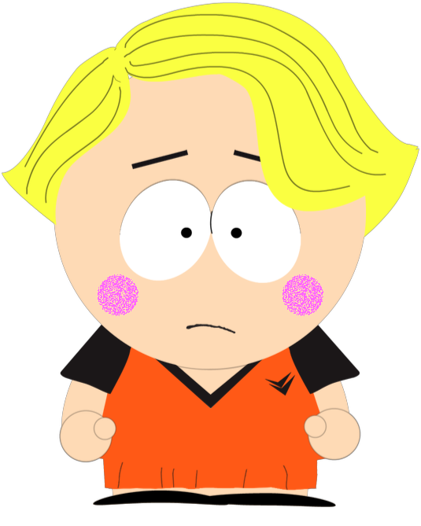
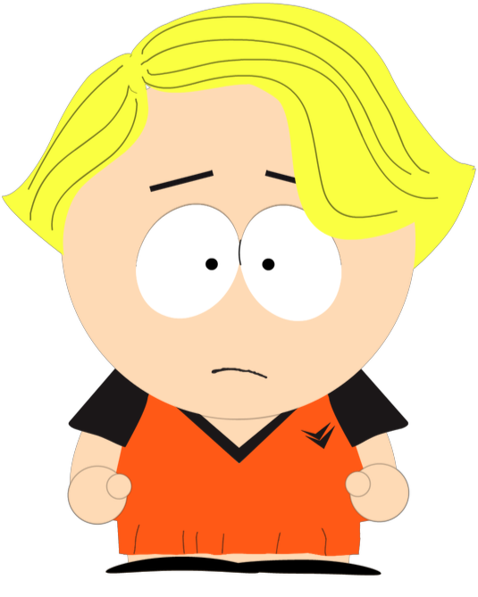
Notes:
Can that happen? Do you think Charlie’s cheeks can turn pink just from being embarrassed? Or do you think Charlie’s cheeks cannot turn pink just from being embarrassed?

Slide 3
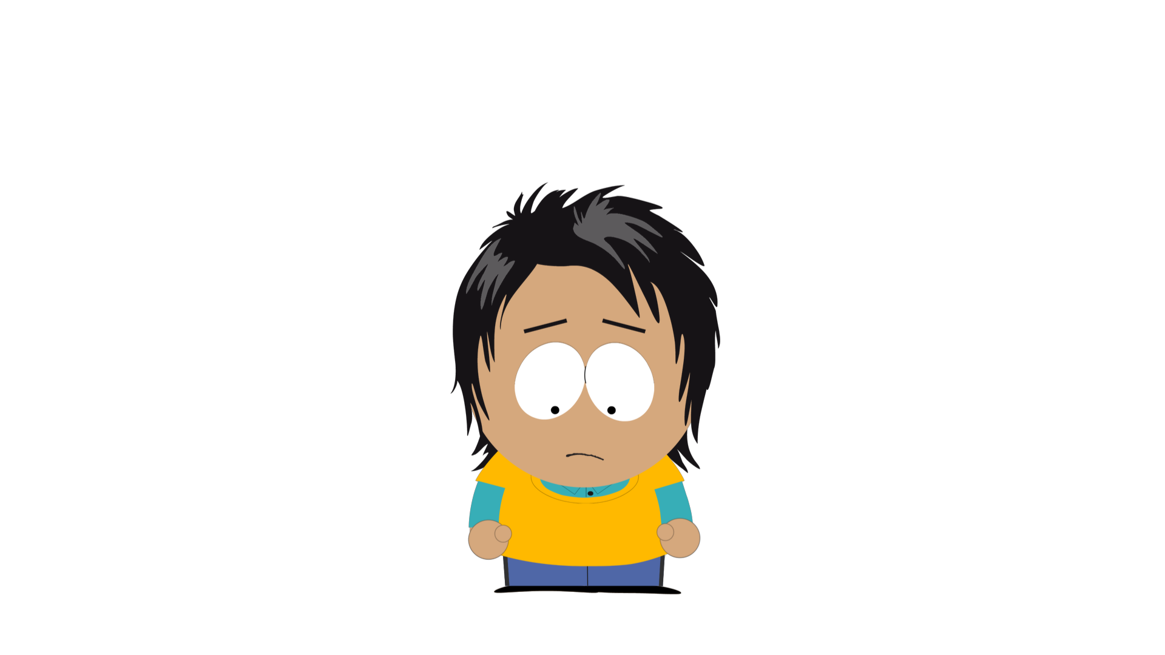
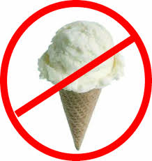
Notes:
This is August. August is sad because her/his mom told her/him that s/he cannot have ice-cream. August heard from her/his friend that if s/he keeps being sad, s/he could get chest pain (That is, s/he could get a sore spot in her/his chest here.).

Slide 4
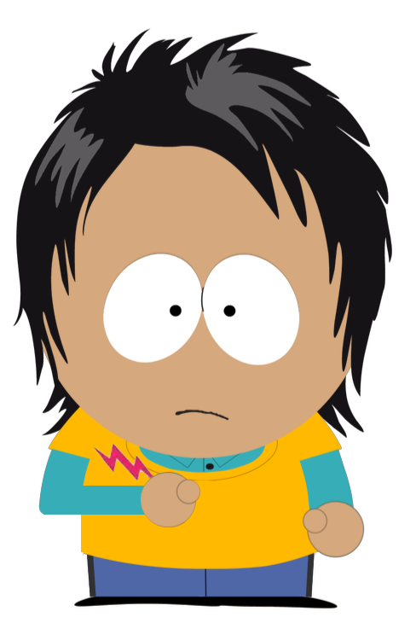
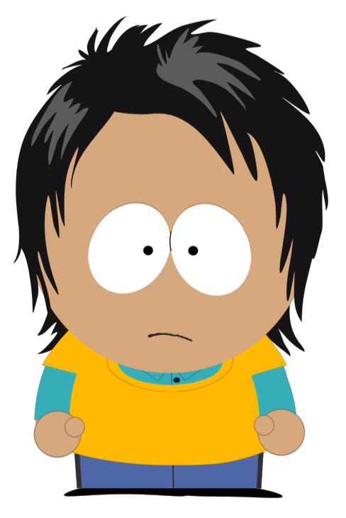
Notes:
Can that happen? Do you think August can get chest pain just from being sad? Or do you think August cannot get chest pain just from being sad?

Slide 5
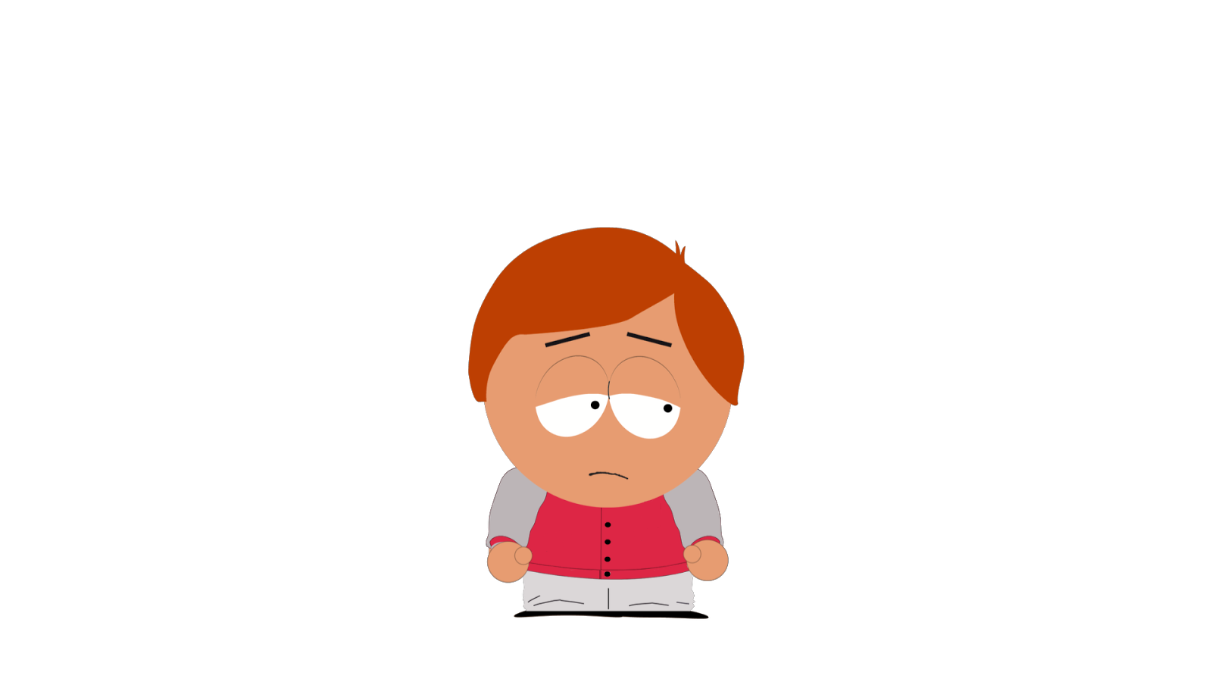
Notes:
This is Aiden. Aiden feels bored because s/he doesn’t have anything to do today. Aiden’s friend says that if s/he feels bored s/he could start to feel tired.

Slide 6
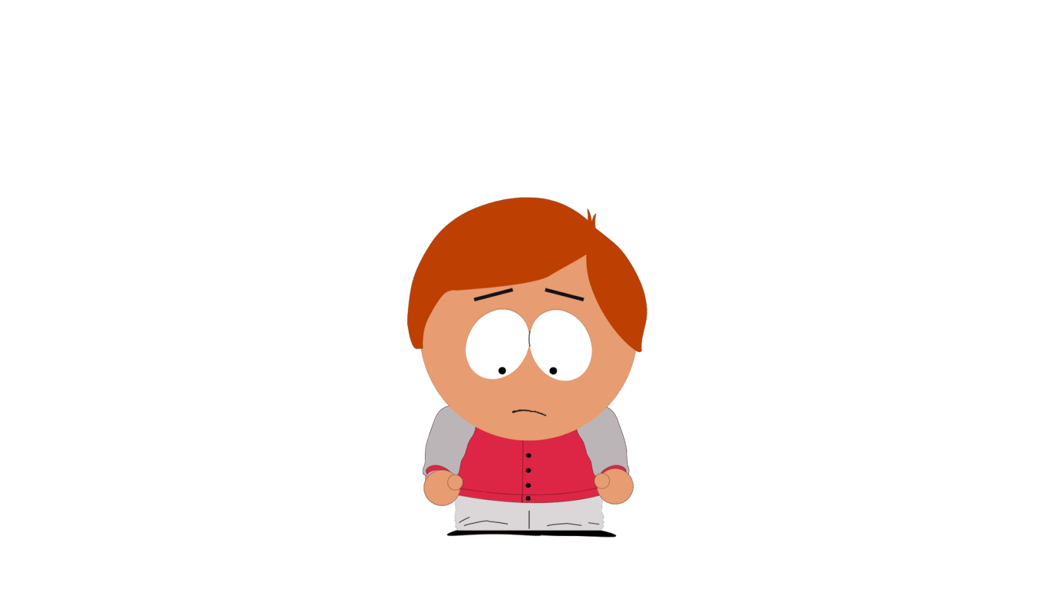
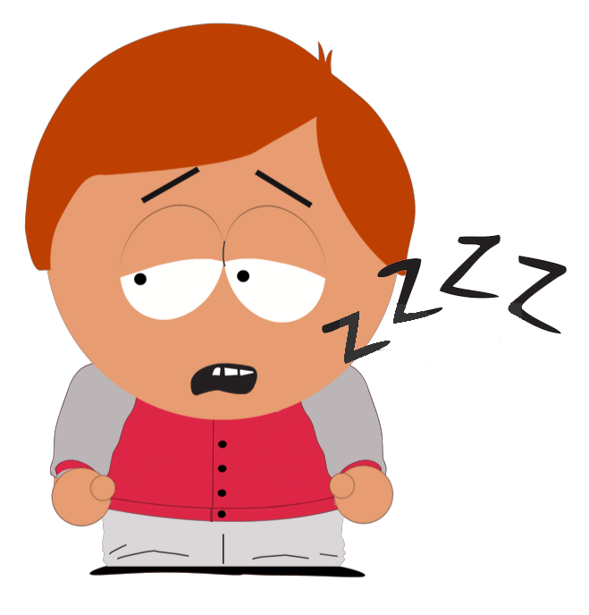
Notes:
Can that happen? Do you think Aiden can feel tired just because s/he’s bored? Or do you think Aiden cannot feel tired just from being bored?

Slide 7
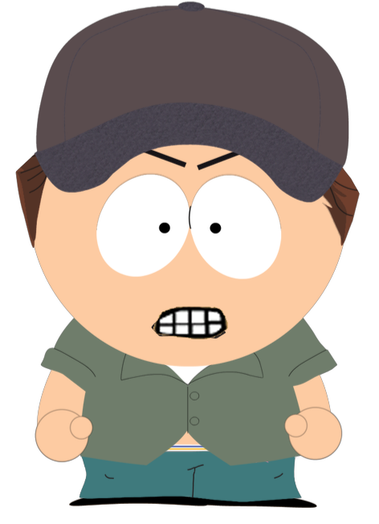
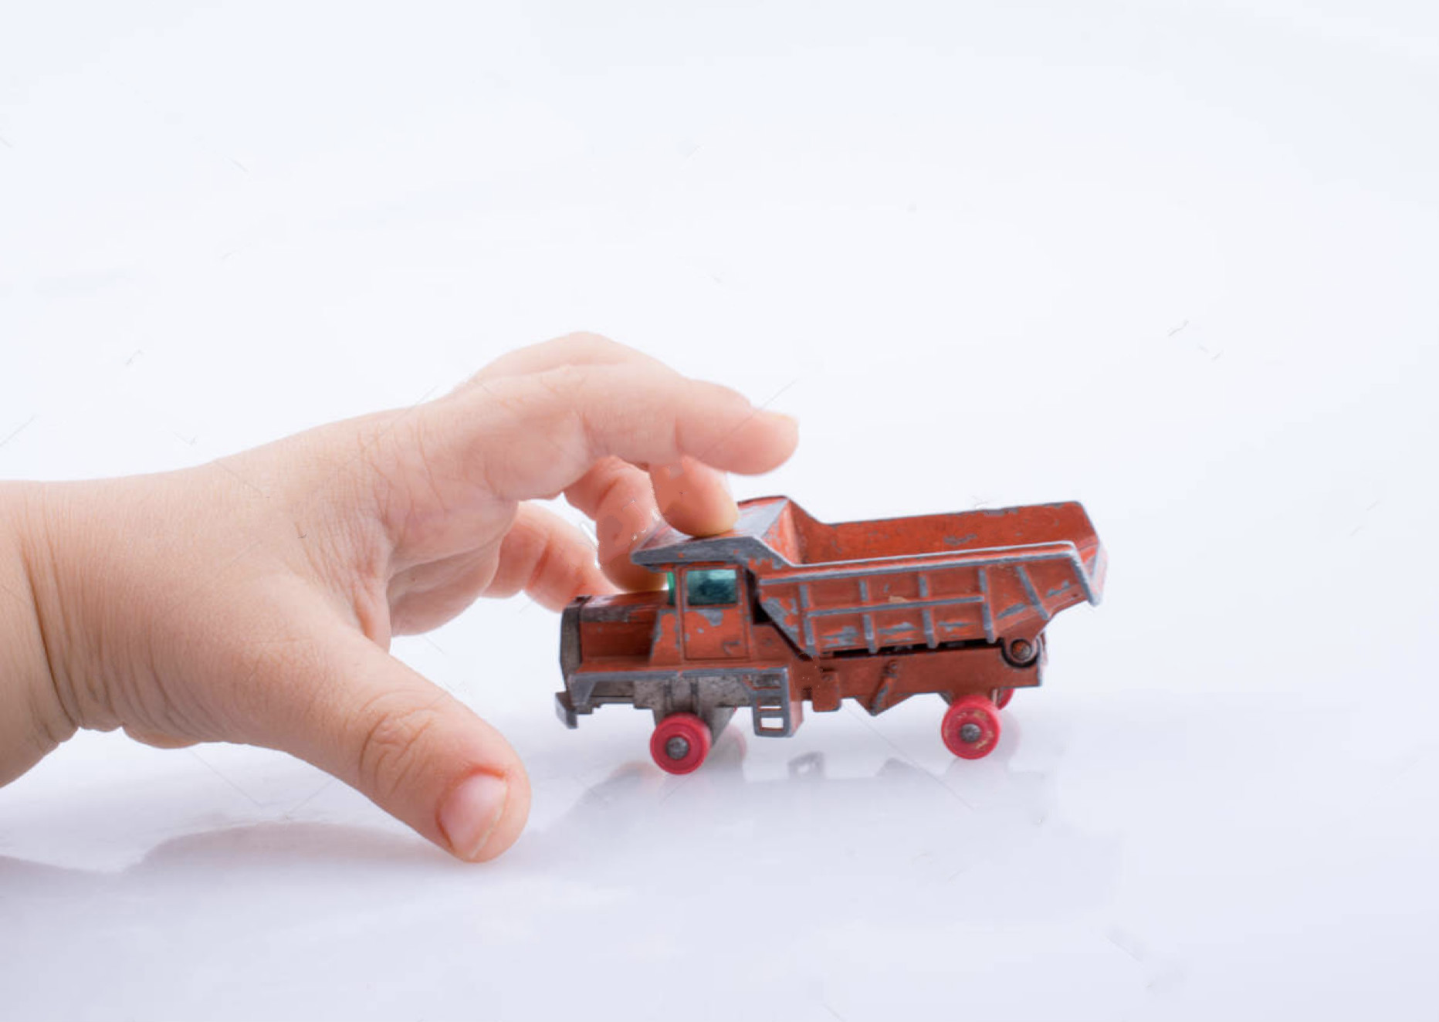
Notes:
This is Alex. Alex is Angry because a classmate took his/her toy away. Alex’s friend told him/her that if s/he feels angry at his/her classmate, his/her fists might start to clench -- that is, it can feel like s/he’s squeezing her/his fingers really tight together like this.

Slide 8
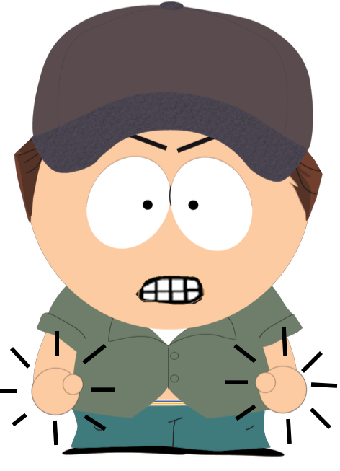
Notes:
Can that happen? Do you think Alex’s fists can clench just because s/he’s angry? Or do you think Alex cannot have her/his fists clench just from being angry?

Slide 9
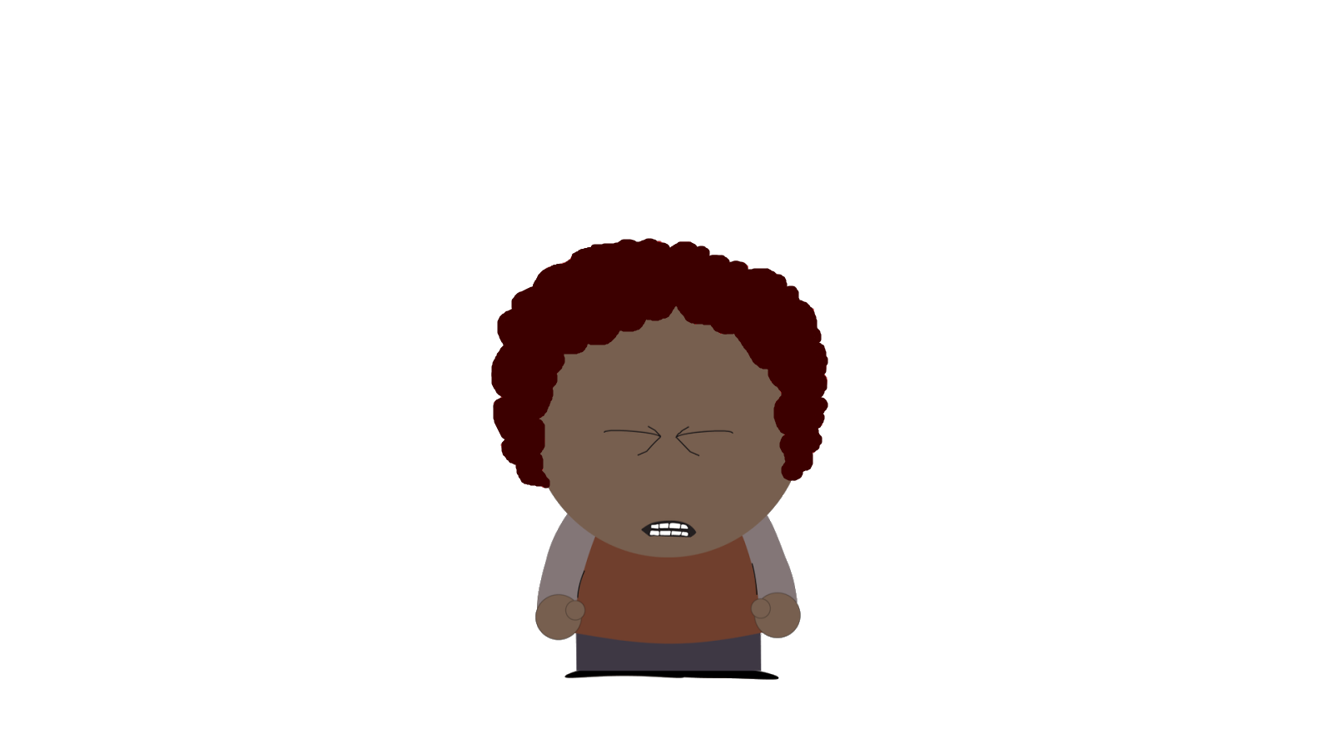
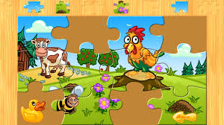
Notes:
This is Ari. Ari is trying to solve a puzzle, but s/he fails. Ari feels frustrated. Ari has heard from his/her brother that if s/he feels frustrated s/he could start to get a headache.

Slide 10
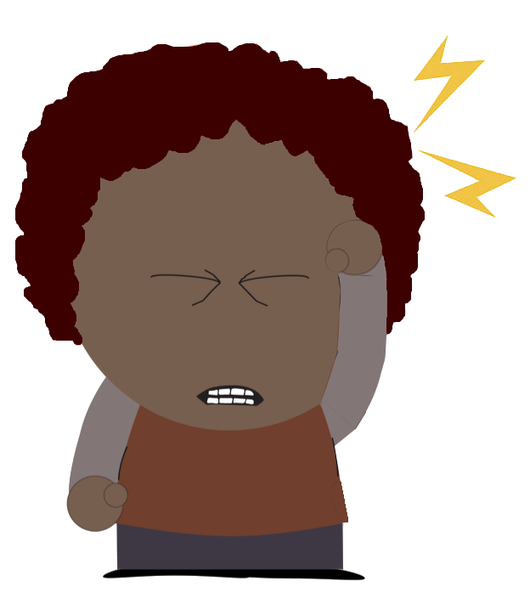
Notes:
Can that happen? Do you think Ari can get a headache just from feeling frustrated? Or do you think Ari cannot get a headache just from feeling frustrated?

Slide 11
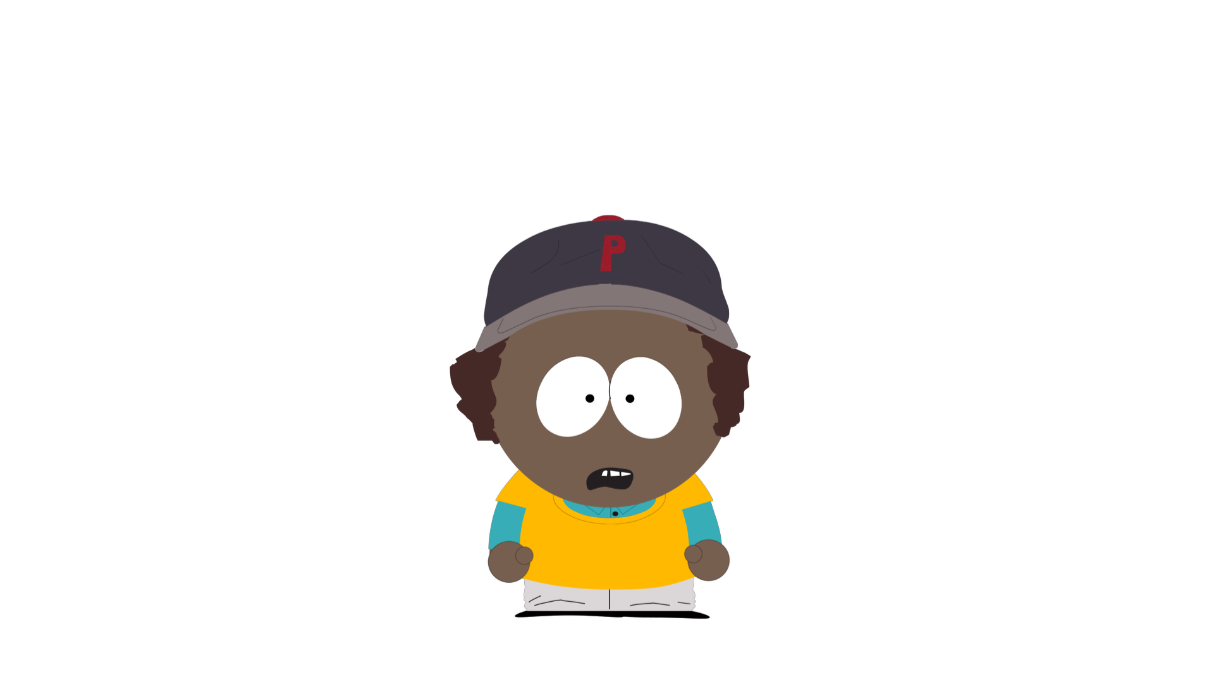
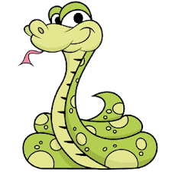
Notes:
This is Blake. Blake sees a snake in her backyard, and s/he feels scared. Blake heard from her/his friend that s/he could start to get a stomach ache from being scared.

Slide 12
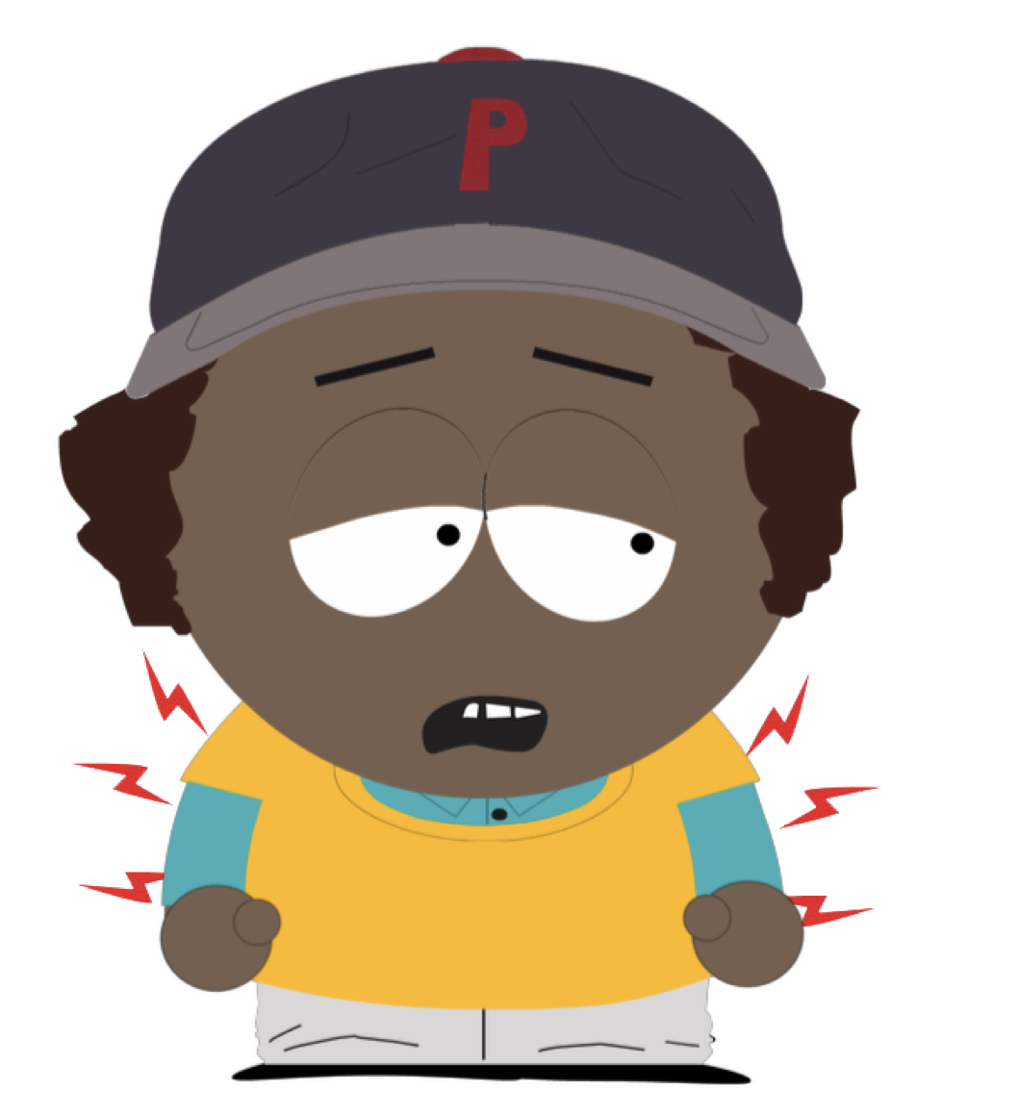
Notes:
Can that happen? Do you think Blake can get stomach ache just from feeling scared? Or do you think Blake cannot get a stomach ache just from feeling scared?

